Slide 1
Exploring Box Office Success
Insights for Microsoft's Movie Studio

Slide 2
Introduction
Microsoft has decided to venture into the movie industry but lacks expertise in the filmmaking process. My objective is to analyze the current movie market and identify the characteristics of successful films, so Microsoft can make data-driven decisions about the types of movies they should produce.
I will be presenting the results of an exploratory data analysis (EDA) aimed at providing actionable insights for Microsoft's new movie studio.

Slide 3
Data Sources
For this analysis, I collected movie datasets from various sources, including Box Office Mojo and IMDB.
The key datasets used are:
imdb.title.basics
imdb.title.ratings
and bom.movie_gross.

Slide 4
Question to consider and Answer
Which is the most recurring movie in terms of genre to determine the successful genre
Which is the best performing studio in domestic ,foreign and the combined gross
Does the runtime affect the rating of the movies

Slide 5
Approach
Data Collection: obtain relevant movie datasets from different sources and prepared them for analysis.
Data Cleaning: address missing values, and formatted the data for consistency.
Data Integration: Join or merge relevant columns from different datasets to create a comprehensive dataset for analysis.
Exploratory Data Analysis: perform various visualizations and statistical analyses to explore movie genres, ratings, revenue, and other attributes.

Slide 6
Key Findings
Most Successful Genres
Documentary
Drama
comedy
Thriller
Horror genres
These are the top-performing genres at the box office.
Below is a bar graph showing the most successful genre.You will not that game show is the least popular movie.

Slide 7
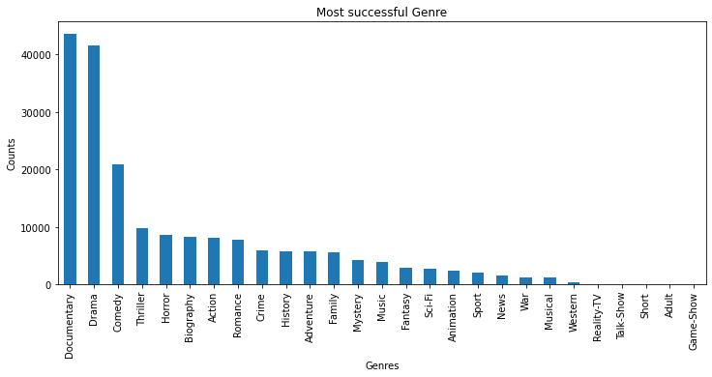
Bar graph showing most successful genre

Slide 8
Domestic vs. Worldwide(Foreign) Revenue:
The majority of movie revenue comes from worldwide markets, that is indicated as foreign gross. This indicates the importance of global appeal in creating the movie.
The below graphs will clearly show that the foreign gross that its leading with 2.5 billion gross compared to the domestic gross of 1.8billion with

Slide 9
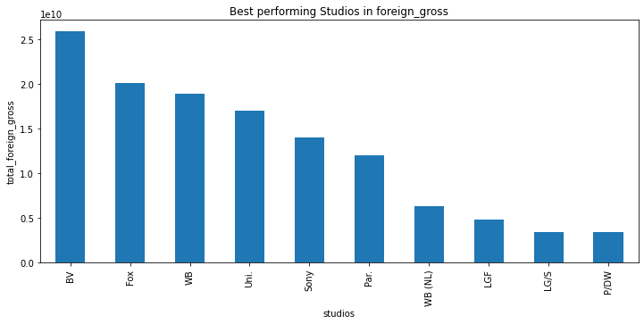
Bar graph as per foreign gross in studios

Slide 10
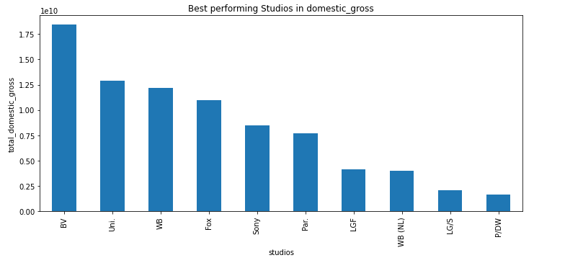
Bar graph as per Domestic Gross for Studios

Slide 11
Movie Ratings
Higher-rated movies tend to have better box office performance.
This is clearly show in the analysis above that the documentary movies are still leading in all aspects.

Slide 12
Recommendations
Based on my analysis, I recommend the following strategies for Microsoft's movie studio:
Focus on High-Performing Genres as shown above.
Invest in Documentary,Drama and comedy, as they have a higher chance of success at the box office.
Prioritize Quality: Emphasize producing high-quality movies that receive positive ratings from audiences.
International Market Consideration: Tailor movie content to have global appeal to maximize revenue from worldwide markets

Slide 13
Conclusion
In conclusion, our exploratory data analysis provides valuable insights for Microsoft's movie studio.
By leveraging the success factors identified, Microsoft can confidently produce films with a higher likelihood of box office success as shown in the graphs.
Adopting a data-driven approach will enhance decision-making, making Microsoft's entry into the film industry a successful and profitable venture.
Microsoft should also research more on how it can differentiate itself from the competitor in the market.
On the other hand Microsoft can partner with the highest performing studios to create movies like the BV.

